Slide 1
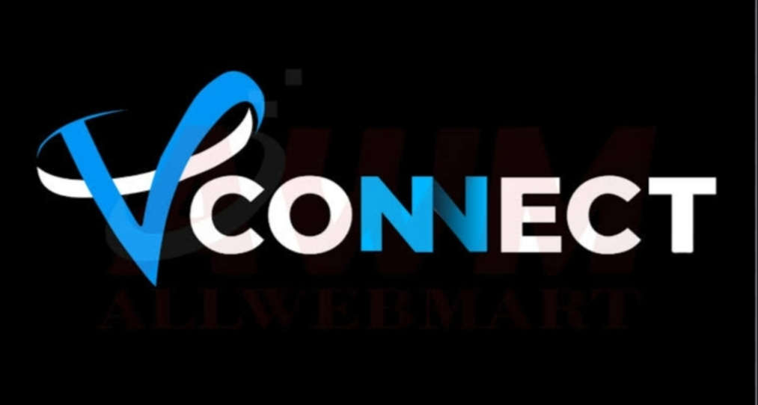
Done by:
BATCH 5B4

Slide 2

CONTENTS:
----> introduction
---->block diagram
----->conclusion

Slide 3
***INTRODUCTION***
The "Vconnect "project leverages the MERN stack to create a robust social media platform. Users can securely register, manage profiles, and join or create "Sub Snappys," topic-based communities. They engage with text-based posts through upvotes, downvotes, and comments, saving posts for future reference.

Slide 4
Moderation tools allow reporting of content, enabling moderators to take actions such as blocking users and deleting posts. Data visualization provides insights into community growth and engagement. Advanced features include API integration, multi-level comments, infinite scrolling, keyboard shortcuts, and chat functionality. Upholding security and modularity, the project offers hands-on experience in building a dynamic web application for fostering connections and discussions.

Slide 5
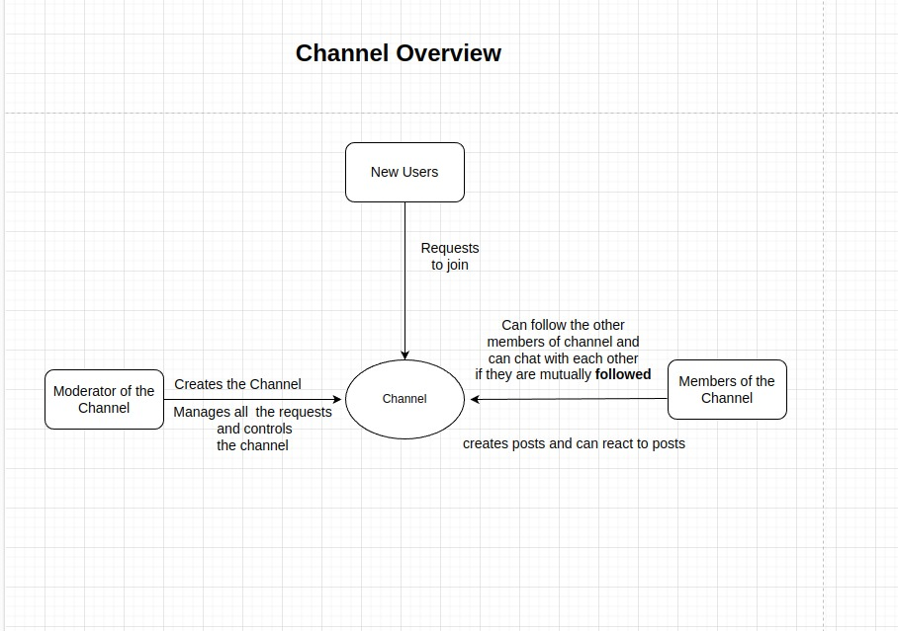
***BLOCK DIAGRAM***

Slide 6
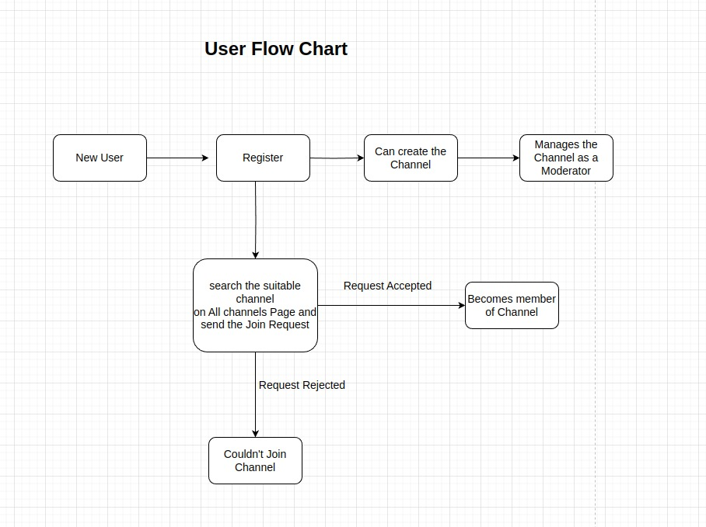

Slide 7
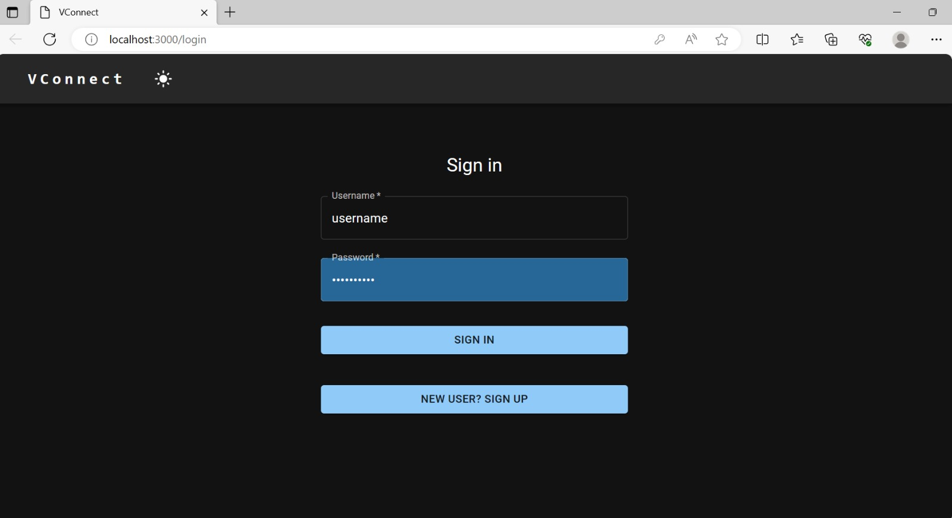
**OUTPUT**

Slide 8

***conclusion***
--->Is a social news website which combines web content, social news, a forum, and a social network into one giant beast of a platform. Registered members can contribute to the site with content such as images, text, videos, and links.

Slide 9
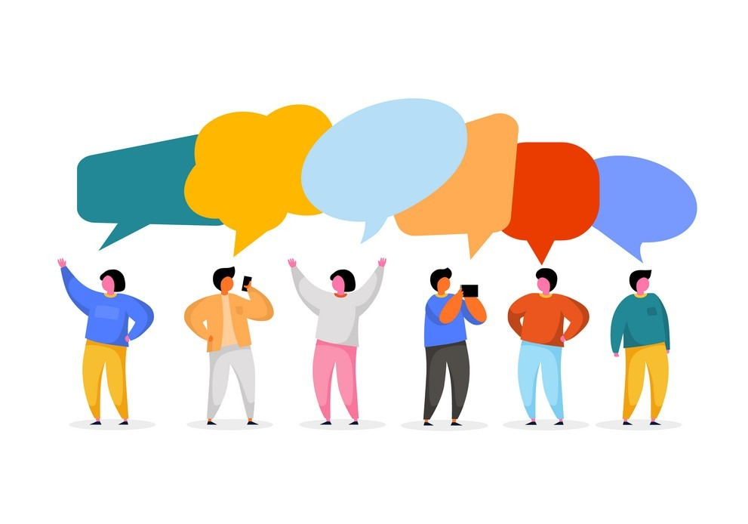
TEAM MEMBERS:
----> Yashwanthi(568)
---->Aveena(582)
---->Bhuvana(575)
---->Charan(5B2)
Guide name
Dr. Srinu sir

